Slide 1
CSI 201
Skills Lab 2
Lumbar Puncture
Daryl P. Lofaso, Ph.D.,M.Ed., RRT

Slide 2
Indications for Lumbar Puncture
To obtain CSF for Laboratory Examination
Administer Medications into subarachnoid space
Perform Myelography
Measure ICP
Dx CNS infections and Inflammatory Diseases

Slide 3
LP Contraindications
Infections at puncture site
Suspected CNS mass lesion
Increased ICP (relative)
Coagulation disorder (relative)

Slide 4
Lumbar Puncture Checklist
Check the indications
Know the risks and how to deal with serious complications
Explain the issues to the patient
Check for allergy to lidocaine or iodine
Consider bleeding tendency / risks

Slide 5
Lumbar Puncture Equipment
Consent form (Signed)
Lab request forms and specimen bottles
Sterile Gloves, sterile gown, mask & eye protection
Local anesthetic
LP Tray

Slide 6
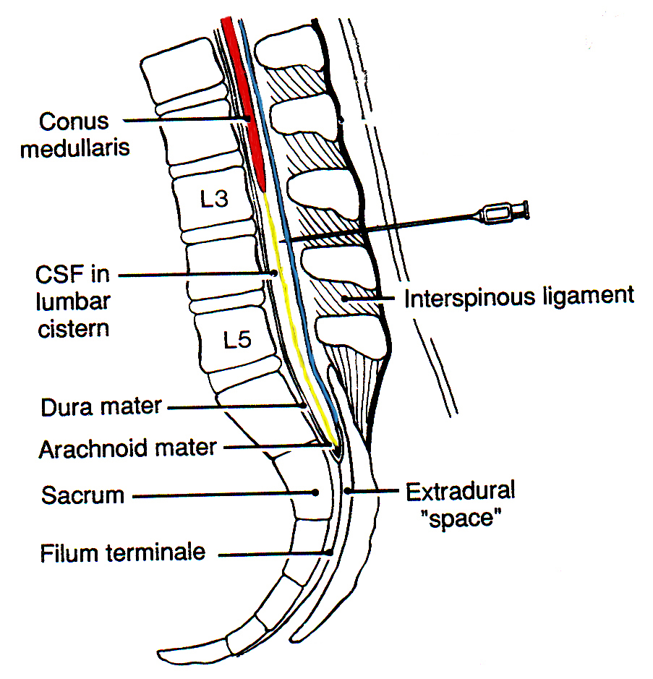
Lumbar Puncture
What structures or layers with the needle pass through before reaching the subarahnoid space?
Skin
Superficial fascia
Superspinous ligament
Interspinous ligament
Ligamentum flavum
Epidural space containing fatty areolar tissue and the internal vertebral venous plexus
Dura mater
Arachnoid mater
Subarachniod space

Slide 7
Invasive/Non-Invasive
Procedure Consents
Date/Time of consent
Indications
Alternative treatment
Risk/Benefits
Documentation that all questions have been answered
Signature of patient or authorized representative before procedure performed & appropriate witness – Date/Time

Slide 8
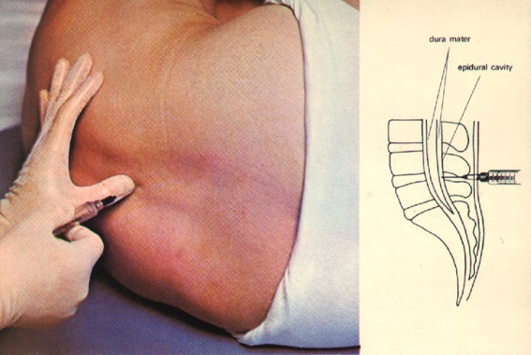
Test CSF
Appearance
Protein
Sugar
Serology
Cell Count
Bacterial or Fungal Cultures

Slide 9
Helpful Hints
What is the most important step before performing a Lumbar Puncture?
Answer: Positioning the Patient

Slide 10
Culture Tubes
Tube 1: Gram stain, (AFB, fungal)
Tube 2: Glucose and Protein
Tube 3: Cell count (RBC, WBC with differentials)
Tube 4: Hold for possible (VDRL, India ink, electrophoresis, antigen panel)
* (Tube sequence may varies per hospital)

Slide 11
Complications to LP
Spinal Headache
Trauma
Herniation
Infection
Hemorrhage
Bloody Tap

Slide 12
Invasive/Non-Invasive Procedure Note
Proper Patient Identification
Site Verification
Pre / Post Medication for pain control
Intra / Post procedure monitoring
Complications, if any
Management of Complications

Slide 13
Universal Precautions
All Patients are potentially infectious.
Good Handwashing is the key to reducing nosocomial infections
Wash before and after patient contact
Wear a mask, eye protection, face shield, and gown when needed

